Slide 2
OCRE 2024
Open Clouds for Research
Environments

Slide 3
What main challenge will be addressed?
How to incorporate commercial digital cloud services in … [the Research and Education community] work, remaining compliant with relevant rules and regulations, including privacy and public procurement, and how to find and acquire suitable services.

Slide 4

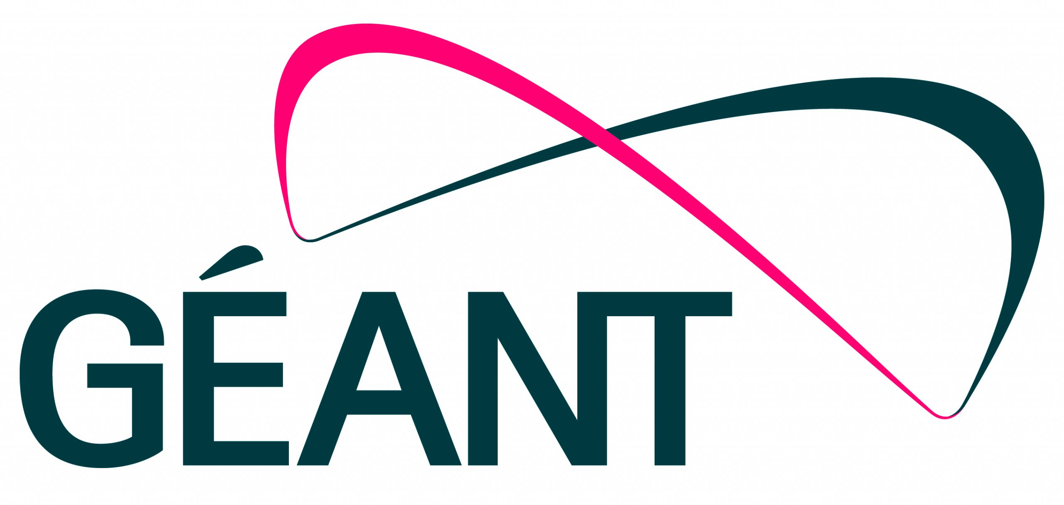
The background and heritage of OCRE
OCRE Framework as best practice and example
In 2016 GÉANT tendered the first IaaS agreements
  Mandated by all NRENs to tender on their behalf
  27 framework agreements were awarded
  Frameworks expired on 31 December 2020
2020 IaaS+ tender was launched – Under the OCRE project
  GÉANT mandated by NRENs to tender on their behalf
  Each country = 1 lot -> suppliers dedicated
  ~ 1050 proposal received / 474 framework agreements awarded (avg. 14 different Cloud platforms available per country).
Prior Information Notice | Market consultation | July 2023
20-03-2024 the new IaaS+ | OCRE2024 published on TED, SIMAP, TenderNed & Find a Tender – 03-02-2025 “live”

Slide 5
GÉANT IaaS+ Frameworks – it’s been quite a journey!
2019 | 2020 | 2021 | 2022 | 2023 | 2024 | 2025
2016 IaaS+ Framework
Tender for 2020 IaaS+ Framework
2020 IaaS+ Framework
Tender for 2024 IaaS+ Framework
2024 IaaS+ Framework

Slide 6
Timeline of the OCRE2024 Tender (preliminary)
13.05.2024
Evaluation
December 2024
20.03.2024
Contract Completion
03.02.2025
Publication*
End November 2024
Start
Award + standstill
Deadline for Call-off Contracts
under OCRE 2020 (30.11.2024)
Commence date
OCRE2024
Duration of framework contracts is up to five (5) years from the Commence Date. Publication will follow on TED.
For Azure: Conditions under OCRE 2020 expire 31.12.2025

Slide 7
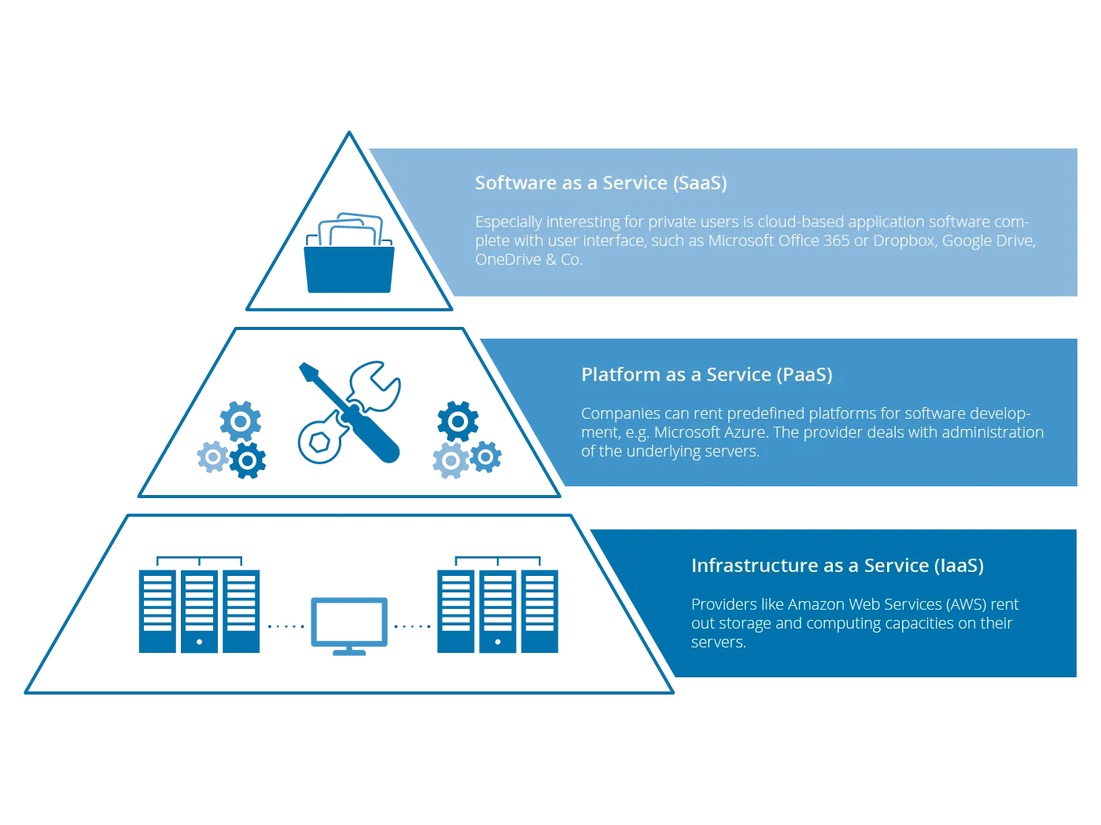
OCRE2024 Scope, Contracts, Lots
GÉANT as Central Purchasing Body
40 buyers – 39 countries
Scope: IaaS+
Contracts:
Frameworks under Dutch law
CoC under local law
Framework
1 Lot per country
Sub-Lots per platform
Max 3 suppliers per sub-Lot
Expected total contract value* 1+ B Euro
5-year Framework durations
Customisation per NREN
Complementary approach
No obligation to procure

Slide 8

Overall aim of OCRE2024
A framework that will make it easy for Customers to consume IaaS+ services in a manner compliant with European procurement legislation and with the best conditions of use
Suppliers offer an IaaS+ feature set which matches the Customer’s needs
Customers get access to a broad range of services fitting their needs from multiple Suppliers
Data is handled safely and securely, and Suppliers meet European and National regulations
Services can be acquired and used through the Customer’s purchasing and management structures (such as accepting Purchase Orders and post pay billing)
Services are connected to and compatible with the Customer’s network and Identity Management capabilities

Slide 9



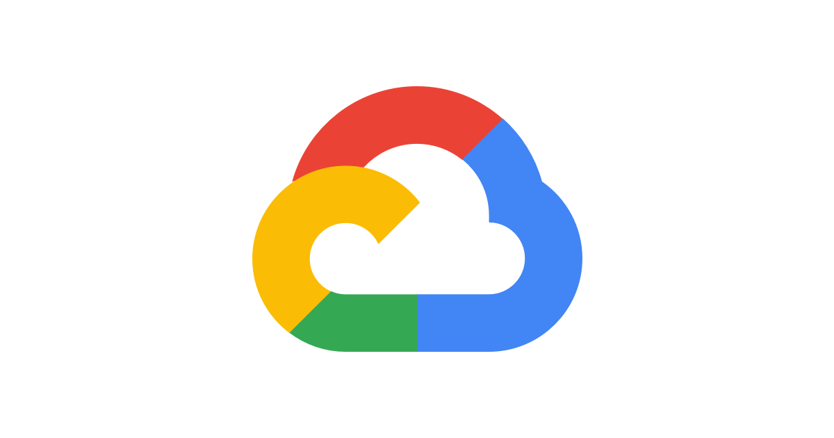

Award Procedure for <name country> (Lot X)
Sub-Lots |  |  |  |  |  |  | …
Rank 1 | Supplier A | Supplier B | Supplier C | Supplier D | Supplier E | Supplier F | …
Rank 2 | ? | ? | ? | ? | ? | ? | …
Rank 3 | ? | ? | ? | ? | ? | ? | …
<name NREN> will receive X% of cost recovery fee and/ or will act as underwriter and sign the Call-off Contracts under OCRE2024
All Suppliers have a preferred platform and can in principle only be awarded to this platform unless there are not enough Bidders
Supplier need to define preferences in case it is awarded highest multiple times
Maximum of three Suppliers represented in total per platform
Uncontested platforms may be awarded to any Bidder, even if the Bidder already has been ranked highest in another competed sub-Lot.

Slide 10
Per den 7/11
”Standstill until 20th November”
Sunet kommer inte att verka som underleverantör
Tar därför inte ut någon avgift
Varje avrop sker mellan slutkund och leverantör
  Svensk lag gäller
Sista dag för förlängning av det nuvarande 30(29)/11 i max 4 år
Azure kan förlängas till max 2025-12-31

Slide 11
Frågor
https://www.sunet.se/services/molnbaserade-tjanster/ocre
cloud-contact@sunet.se

